Slide 1






CLIM-PACT
Helping National Parks to prepare for climate-change driven ecosystem and ecosystem service change
Lead: Richard Davy, Senior scientist Nansen Center, Bergen

Slide 2
Project objectives
Integrate climate change risk assessments into national park management to support biodiversity conservation and ecosystem service sustainability under climate change
Work together to identify key priorities for each park
Use experts in climate and ecosystems to identify most important climate drivers
Create high-resolution (1km) climate projections for these drivers within each park
Develop interactive decision-support tools
Create adaptive visitor and conservation policies
Establish a climate change response team to ensure sustained support

Slide 3
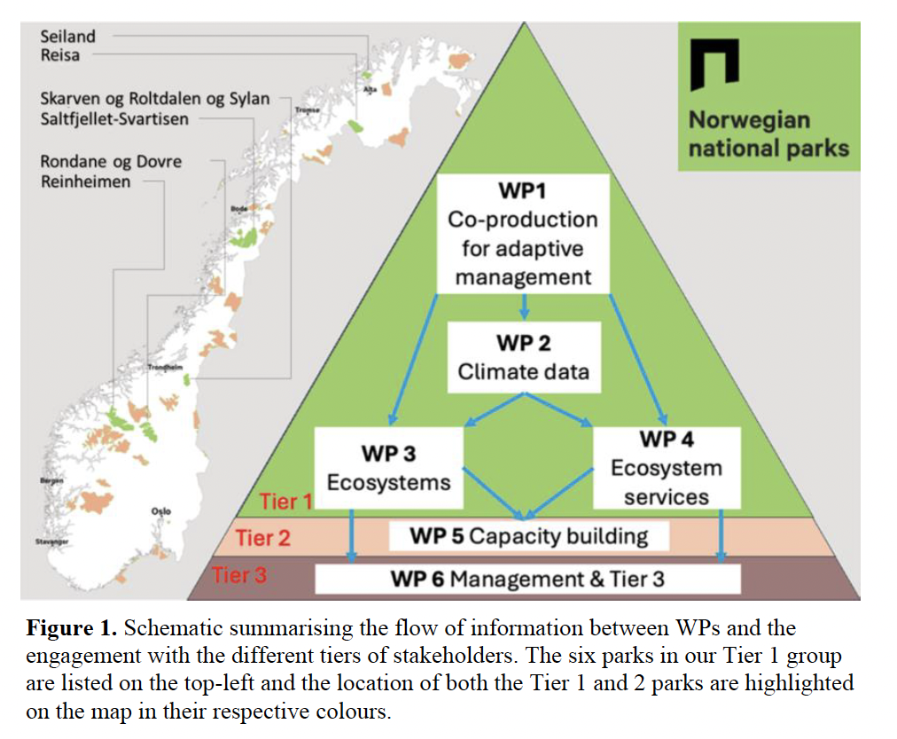
Our project framework
Park managers are at the center to ensure usable results.
Develop the pipelines to make sure we provide the latest knowledge on climate projections and climate-ecology linkages
Capacity building within park management through training in co-developed decision-support tools
Tiered engagement approach to ensure depth and breadth of input into project outcomes

Slide 4
Developing climate change scenarios for Reisa and Pasvik parks
 | Vegetation |  | Wildlife |  | People
 | Orchids | Old-growth forest | Arctic fox | Reindeer | Winter Access | Salmon fishing
Summer heatwaves
Snow Cover
Soil Moisture
Wind Exposure
Spring rainfall
 | Vegetation |  | Wildlife |  | People
 | Orchids | Old-growth forest | Arctic fox | Reindeer | Winter Access | Salmon fishing
Summer heatwaves
Snow Cover
Soil Moisture
Wind Exposure
Spring rainfall
Identify priorities specific to each park
Identify climate drivers of these priorities
Match drivers to priorities
Diagnose range of scenarios for each climate driver
 | Vegetation |  | Wildlife |  | People
 | Orchids | Old-growth forest | Arctic fox | Reindeer | Winter Access | Salmon fishing

Slide 5
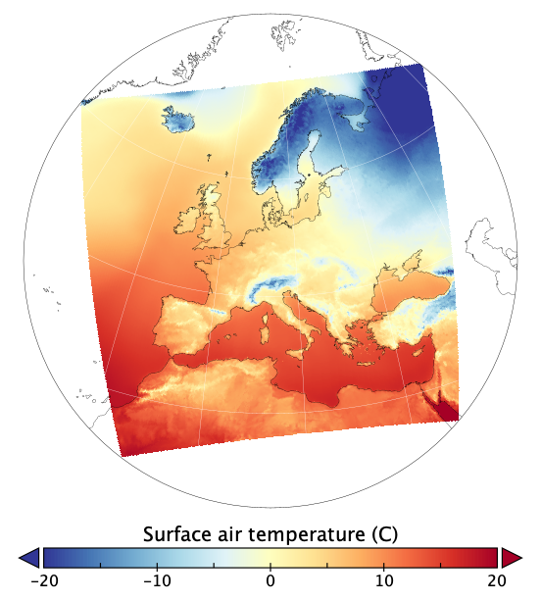
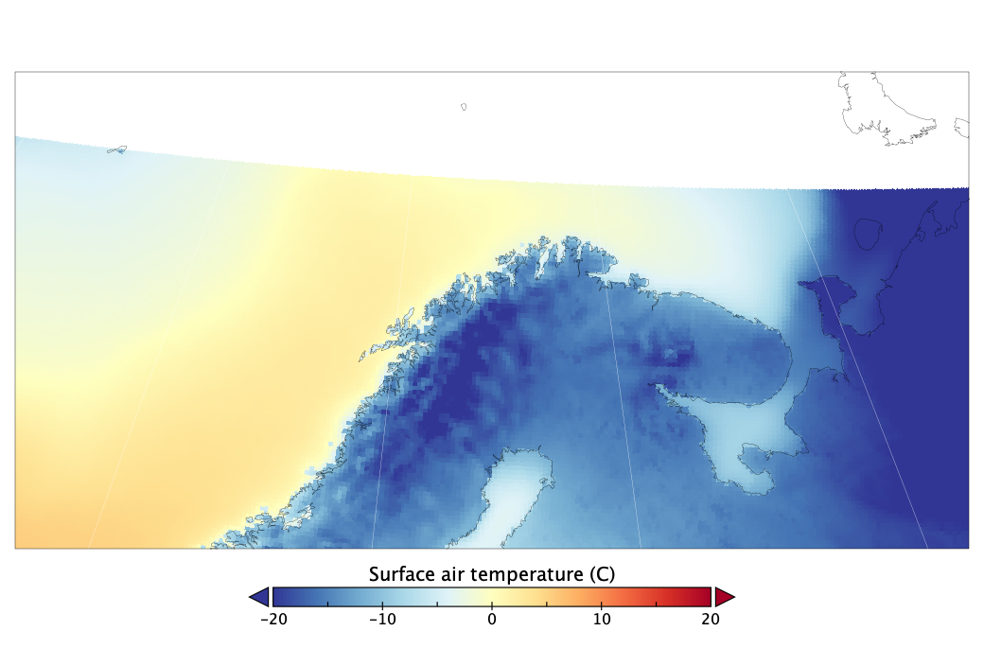
Pilot project
Developing climate change scenarios for Reisa and Pasvik parks
70 model simulations of climate change
Simulations cover 1900-2100
Take averages over 500 km square region
Gives robust view of regional climate change

Slide 6
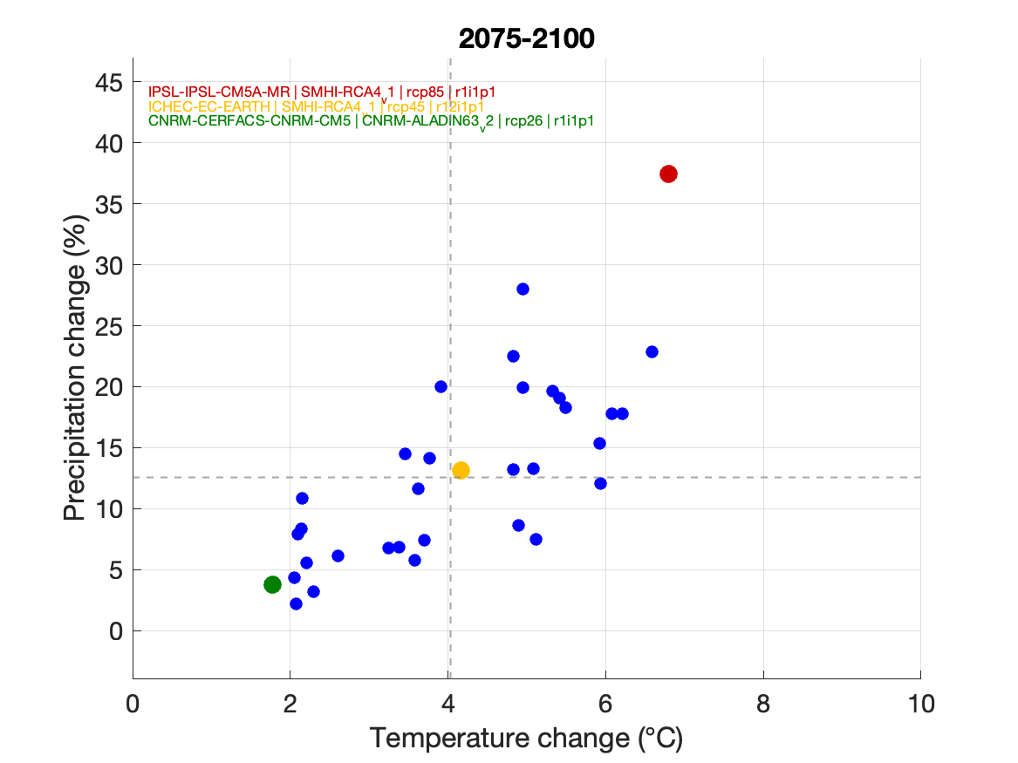
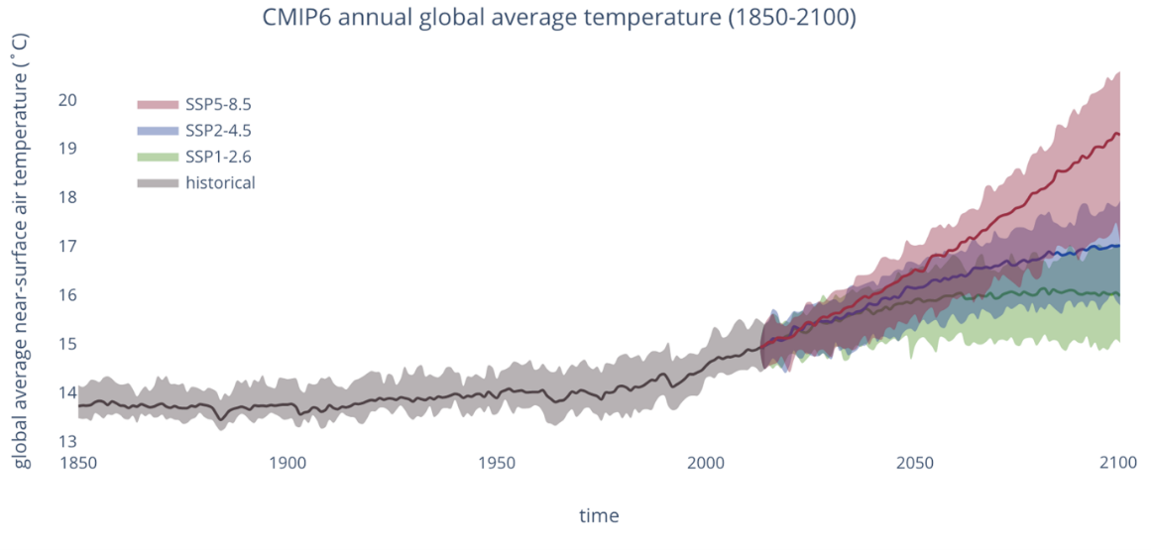
Developing climate change scenarios for Reisa and Pasvik parks
Consider three future periods:
Near future (2024-2050)
Mid-future (2051-2075)
Far-future (2076-2100)
Diagnose range of possible climate futures
Select three cases for further analysis: “cold-dry”, “expected”, and “warm-wet”

Slide 7
Summary of regional climate change
Warmer means Wetter overall
Uncertainty is enormous:
Less than 2ºC warming, no change in precipitation
7ºC warming and 40% wetter

Slide 8
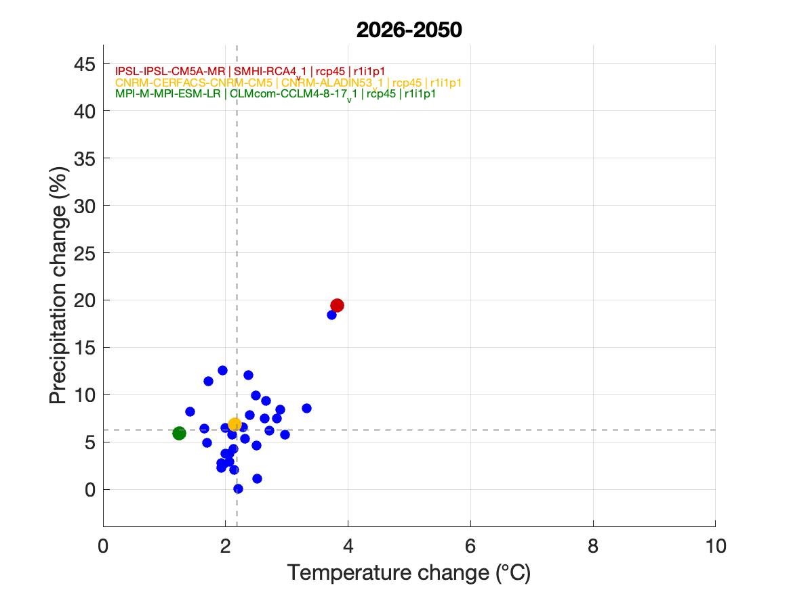
Summary of regional climate change
Warmer means Wetter overall
Uncertainty is enormous:
Less than 2ºC warming, no change in precipitation
7ºC warming and 40% wetter
Up to + 20% precipitation, +4ºC warming in the next 25 years.

Slide 9
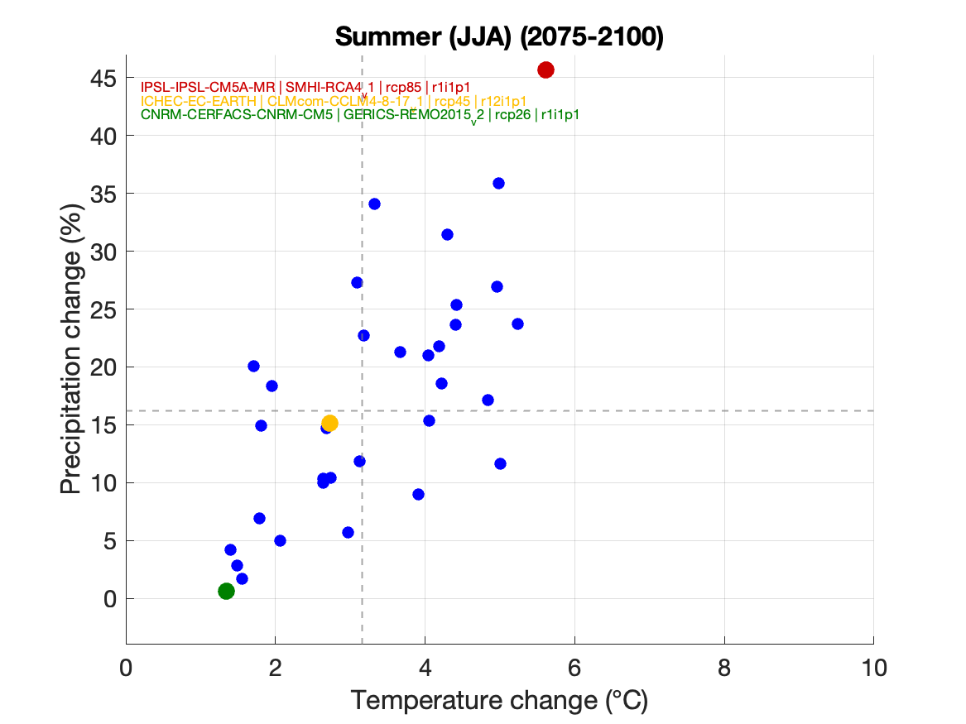
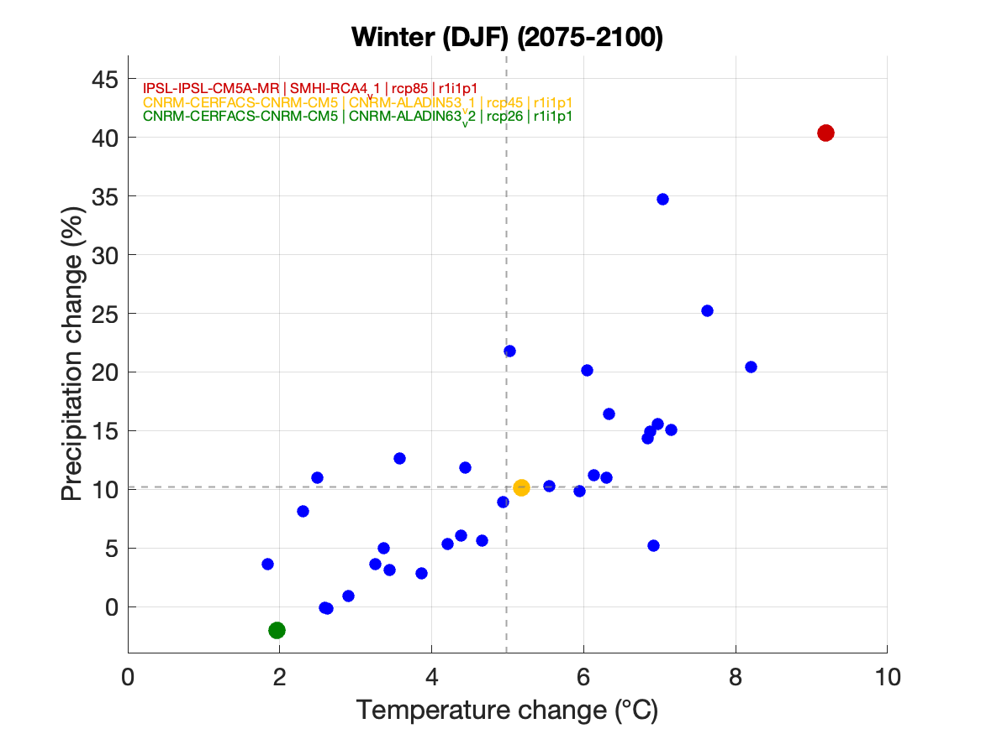
Summary of regional climate change
Warmer means Wetter overall
Uncertainty is enormous:
Less than 2ºC warming, no change in precipitation
7ºC warming and 40% wetter
Up to + 20% precipitation, +4ºC warming in the next 25 years.
Summers have greatest risk of increased precipitation. Winters have greatest risk of strong warming

Slide 10
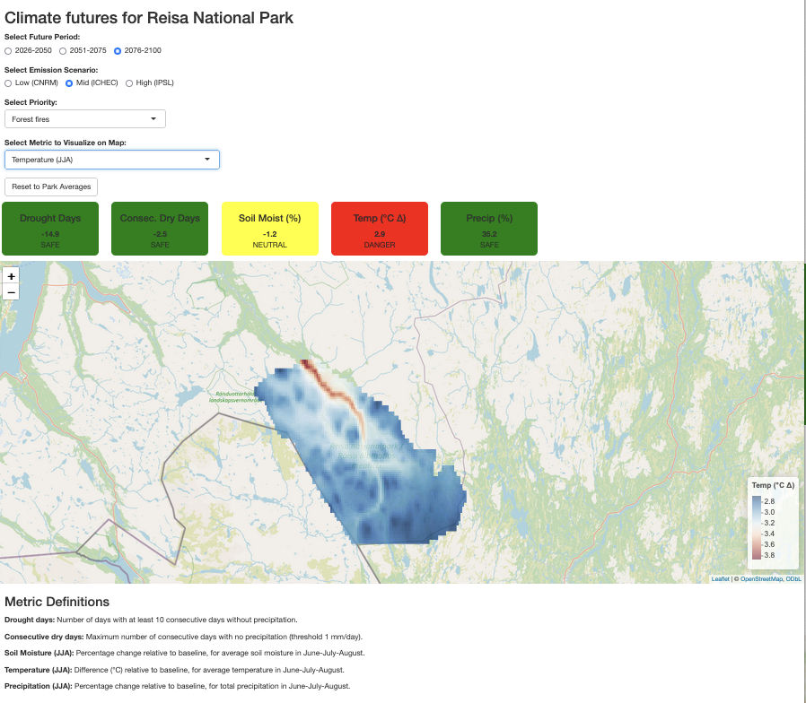
Decision support tools
Create web-based tools to visualise how climate drivers change
Example: forest fires could become a risk in the future
Intuitive tool to navigate alternative climate futures, gain overview of risks to park priorities

Slide 11


(1) Who are we?
Richard Davy Erik Kusch Anna Sveinsdottir Aase Lundberg
Climate Scientist Ecosystem research Human geographer Human geographer

Slide 12
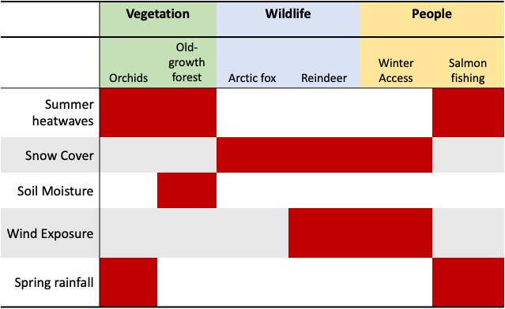
(2) What do we want to achieve?
Work together to
(a) Identify priorities in your park
(b) Develop customized projections of climate change and uncertainty
(c) Establish how these possible climate futures would affect the ecosystem and services in your park
(d) Help you implement this knowledge into your management plans

Slide 13
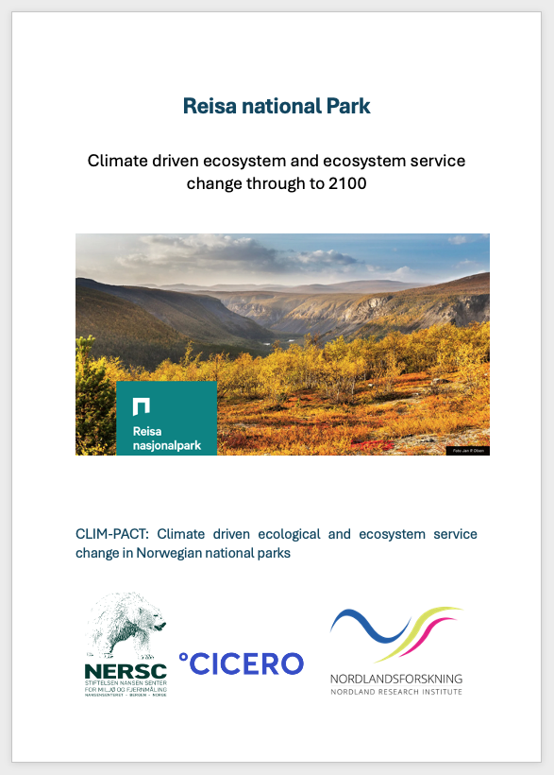
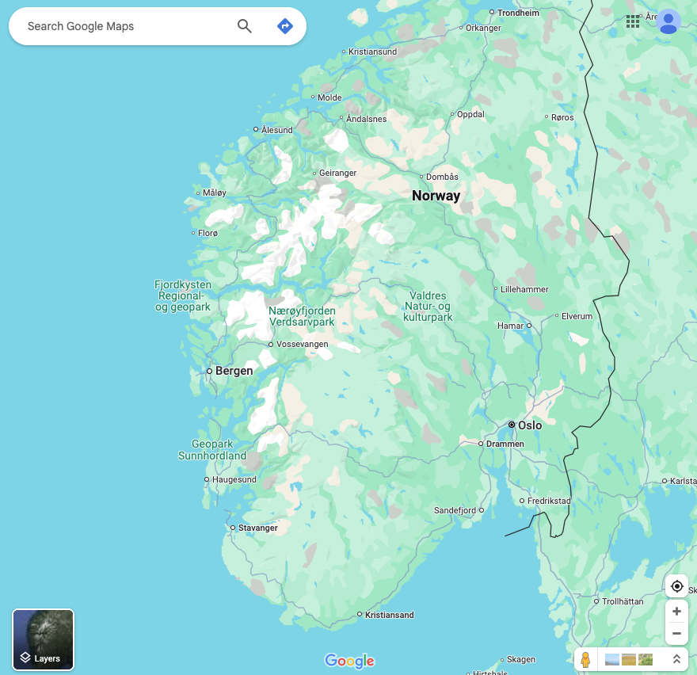
(3) How can we help?
(a) Summary reports for every national park.
(b) Develop web-based tools to visualise the effects of climate change on park priorities
e.g. How will expected presence of red-list species change in the future
(c) Courses on learning to use these tools and the background material
2070
2050
2030

Slide 14
(4) Timeline for implementation (Tier 1)
Tier 1
All participation costs paid for by CLIM-PACT
Join two 2-day workshops
to identify priorities
(we visit you)
First version of tools
(we visit you)
Follow-up meetings (online)
Integrate into park management plans, training on tools
(we visit you)
2026 2027 2028 2029

Slide 15
(4) Timeline for implementation (Tier 2)
Tier 2
All participation costs paid for by CLIM-PACT
First version of tools
(online)
Feedback on climate drivers (online)
Report on climate drivers,
Training materials on tools
(online)
2026 2027 2028 2029

Slide 16
Next steps
We have:
6 parks in our Tier 1 group (joining workshops from 2026)
30+ parks and protected areas in our Tier 2 group
Timeline:
26th Feb Registration of interest in joining either Tier 1 or Tier 2 reference group
5th March Proposal due to Research Council
Sep 2025 Reviews and funding decision from Research Council
Feb 2026 (Hopefully!) CLIM-PACT begins and we start with in-person workshops…

Slide 17

Climate change response team – providing lasting support
Inspired by the
National Park Service (USA)
Create a team of Climate, Ecology, and Human geography specialists on retainer to provide support for:
Providing scenarios of climate/ecosystem/ecosystem-service for parks
Training and further development of decision support tools
Assist with project design for new adaptation initiatives
Requires:
Long-term financial support
(Miljødirektoratet?)

